Slide 1
What’s Left to Say about Racial Affirmative Action in the US?
Glenn C. Loury, Brown University
Presidential Address
Eastern Economics Association
New York City, May 2013

Slide 2
A Definition of Racial Affirmative Action:
AA = {concern about ‘race’} + {concern for ‘equality’ of groups}
+ {need to ration access to elite positions}
That is, the practice of racial AA is grounded in four premises:
(1) A hierarchy of positions with the more desirable being scarce.
(2) Some social/political significance imputed to racial identity.
(3) Substantial outcome disparity between these racial groups.
(4) A desire to increase representation of disadvantage group.

Slide 3
AA has always been controversial in the US
AA is a longstanding but legally/politically contested policy in the US.
AA faces uncertain future – especially in public higher education – given the important case (Fisher v. Texas) now pending before the US Supreme Court.
Yet AA emerged out of our Transition Problem (i.e. the need to confront ongoing legacy of past discrimination given that substantial racial inequalities persist into the present, despite successes of the civil rights era.)

Slide 4
“Transition Problem” in the US: Persistent Racial Inequality
EDUCATION: Percent of Native-Born, Non-Hispanic Men and Women Aged 25 to 34
Reporting a Four-Year College Education
EARNINGS: Median Wage and Salary Earnings for Native-Born Non-Hispanics Reporting Earnings

Slide 5
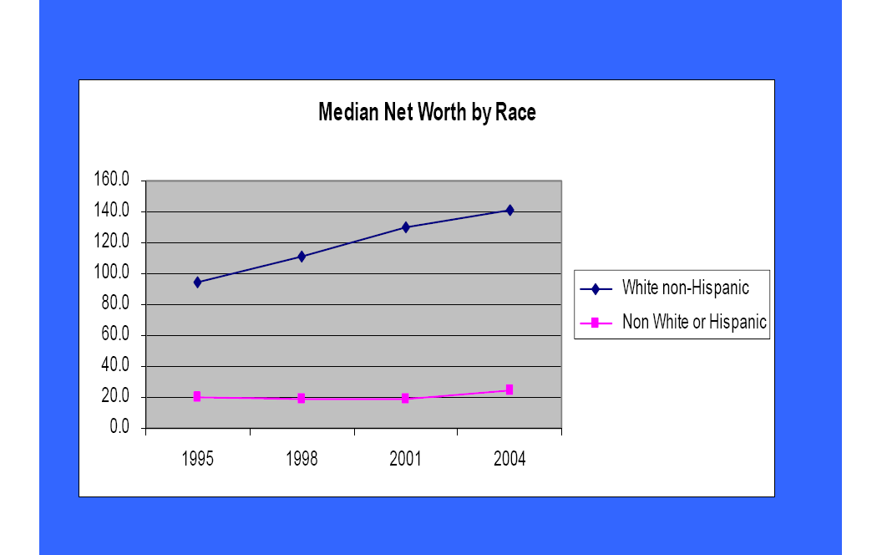
Percent of Native-Born Non-Hispanics of All
Ages Below the Poverty Line; 1968 to 2007
Percent of Native-Born Non-Hispanic Children Under
Age 18 Below the Poverty Line; 1968 to 2007
HOME OWNERSHIP

Slide 6
So, Racial Inequality Persists into 21st Century
But, Is Affirmative Action the Right Response to this ‘Transition Problem’ in the US?
Increasingly, the answer here has been a resounding “No”:
Use social disadvantage not racial identity.
Blacks should focus on skill development not preferences.
It’s time to move on from the civil rights era remedies…
Thus, earlier this month the Court heard oral arguments in the case Fisher versus University of Texas, Austin. Informed observers think the Court likely to further limit use of race in public university admissions and, by inference, elsewhere.

Slide 7
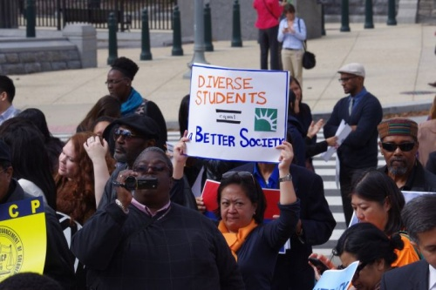
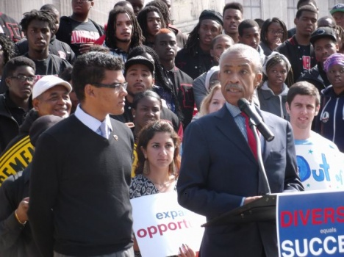

High Stakes in Fisher v. Texas
Supporters rally for Affirmative Action at Supreme Court

Slide 8
Arguments in US against Affirmative Action
Non-discriminatory ideal requires the state to be “color-blind”
  Want to end racial discrimination? Then stop discriminating by race!
Yet, affirmative action is premised on a cognizance of race:
  Policy makers and individuals induced to take note of racial identity, thus reinforcing tendency for people to think in such terms
  Beneficiaries racially stigmatized
  Non-beneficiaries harbor resentment
Despite any short-term benefits, AA ensures that the ultimate ideal – a CB society – may never be achieved.

Slide 9
Arguments in US for Affirmative Action
“Blindness” the wrong goal:
  Non-discrimination ideal important, but not same as “blindness.” E.g., enforcing laws against discrimination may require taking cognizance of race.
  “Blindness” norm applies only to formal, not to informal interactions.
  Effects of unjust past discrimination can’t be overcome with only CB policy.
AA is but a temporary policy to promote transition to full equality
  May actually enhance, not retard, incentives for beneficiaries
  Despite perceptions, hurts a relative few among non-beneficiaries
  Much of AA stigma for beneficiaries reflects latent racism
  Why is resentment reserved for race-based but not (say) gender-based AA?
  Isn’t racial diversity a value in its own right? How other than AA to achieve it?
  Standards of ‘merit’ highly subjective; AA opponents act as if they were not (e.g., case of Cornel West vs. Larry Summers at Harvard)
Despite some problems, AA has proven effective at helping create a larger black middle class since its advent in the 1960s.

Slide 10
Yet AA Is Being Practiced Globally
E.G.
  South Africa: ‘Black Economic Empowerment’ policy post-Apartheid with racial hiring guidelines for firms
  India: extensive AA for “scheduled castes/tribes”
  Malaysia: “New Economic Policy” introduced after ethnic riots in 1960s; most of NEP’s AA features remain in place
  Also Brazil, Europe (esp. France), the USA, China
  [I even participated last summer in an international conference on AA in Kathmandu, Nepal (!!)]
So, a rigorous analysis is of value regardless of how one feels about racial AA in the US.

Slide 11

See! I really WAS in Kathmandu!!

Slide 12


Slide 13


Slide 14
Questions for economic analysis raised by AA:`
What effect does AA have on the formation of racial stereotypes? (Coate/Loury, AER, 1993)
How does affirmative action alter the incentives to invest in HC? (Coate/Loury, AEA Proceedings 1994)
Is it more efficient to use AA earlier or later in the skills development process? (Fryer/Loury, JPE 2014)
Can AA goals be achieved without explicit racial discrimination? (Fryer/Loury/Yuret, JLEO, 2008)

Slide 15
Many of the key issues are empirical. So, what is there left for an applied economic theorist (like me!) to say now about affirmative action policies?
I will describe a theoretical model exploring Questions (2)-(4) above (re. incentive issues; timing issues; and the “blindness constraint.”)

Slide 16
The Abstract Design Problem: A Simple Theoretical Model of Optimal AA Policy
(Adapted from my paper joint with Roland Fryer of Harvard University:
“Valuing Diversity: The Simple Economics of Affirmative Action Policies,” which is forthcoming in the JPE, 2014)

Slide 17
Dimensions of Policy Design
In general one can distinguish affirmative action policies along two dimensions: Timing and Sightedness
Timing refers to where in the development process a policy operates – ex ante (at the development margin) or ex post (at the assignment margin)
Sightedness refers to whether the policy is group-blind or not – that is, whether or not implementing the policy requires information about an individual worker’s group identity.

Slide 18
Basic Elements of the Model
- A continuum of workers of unit mass; two groups, A and B
- A continuum of ‘slots’ of less than unit mass, each to be filled by one worker
- An ex ante stage, where workers acquire human capital (or not)
- HC investment (stochastically) raises worker productivity
- HC costly; cost distributions differ between groups A and B
- An ex post stage, where only some workers gain access to ‘slots’
- Workers in a ‘slot’ generate output proportional to productivity
- ‘Slots’ are privately held, inelastically supplied, and acquired by highest bidders. A group’s representation amongst slot-holders reflects the distribution of ex post productivity for that group.

Slide 19
Preview of results
In baseline model under laissez-faire, CE is efficient; the disadvantaged (B’s) acquire less HC; and they are underrepresented in slots.
Under sightedness, optimal AA policy entails ex post (late) but no ex ante (early) intervention on behalf of the disadvantaged group.
Under blindness, optimal AA policy entails subsidy for slots ex post. HC subsidies are desirable ex ante if and only if the disadvantaged group are relatively more numerous on development margin than on assignment margin.
(My Bottom Line: Under a plausible condition, if you think “diversity” important but don’t like “racial preferences” then you should be strongly in favor of universal subsidies to human capital acquisition…)

Slide 20
Figure 1: Sequence of Actions
(1) Development vs. Assignment Margin
(2) Blind vs. Sighted preferential policy.
Development
margin
Assignment
margin
Regulator
commits
to a policy
Agents
receive
endowments
Agents
choose
effort
Agents
learn their
productivities
Slots
are
acquired
Production
occurs
and payment
received

Slide 21
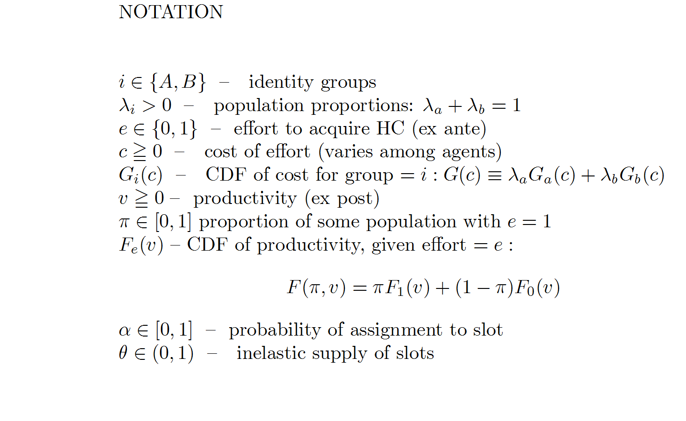

Slide 22
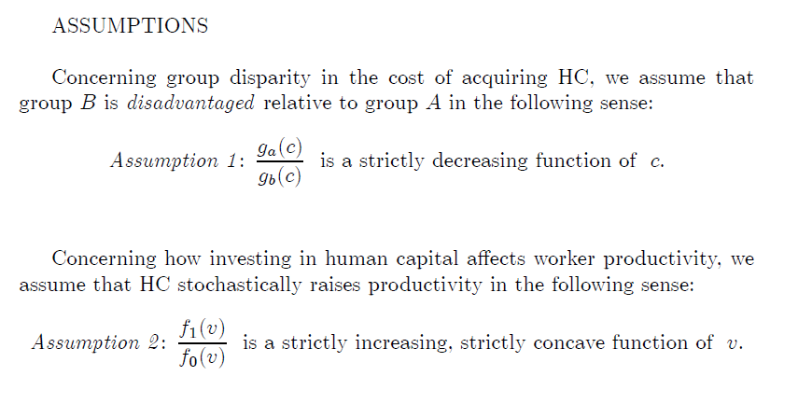

Slide 23
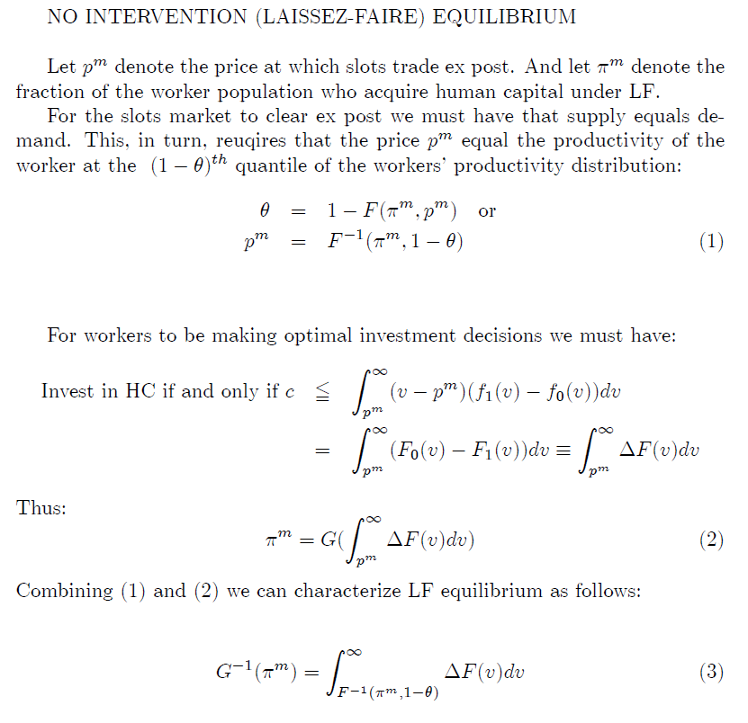

Slide 24
1
p
Figure 2: Competitive Equilibrium under Laissez-faire

Slide 26
It is easily seen that LF equilibrium is Pareto Efficient. Thus:

Slide 29
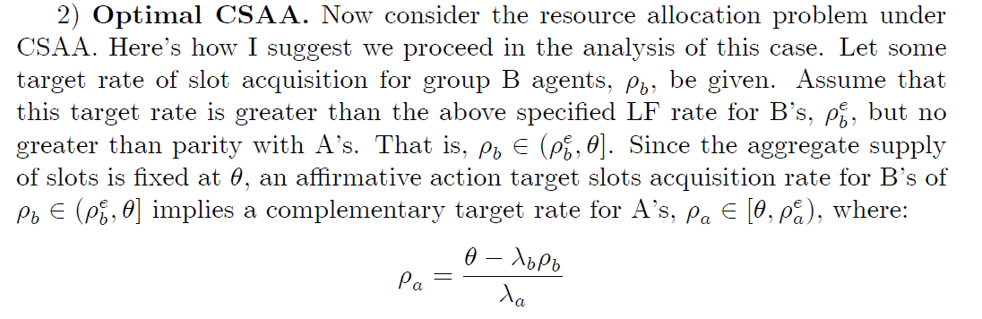

Slide 30
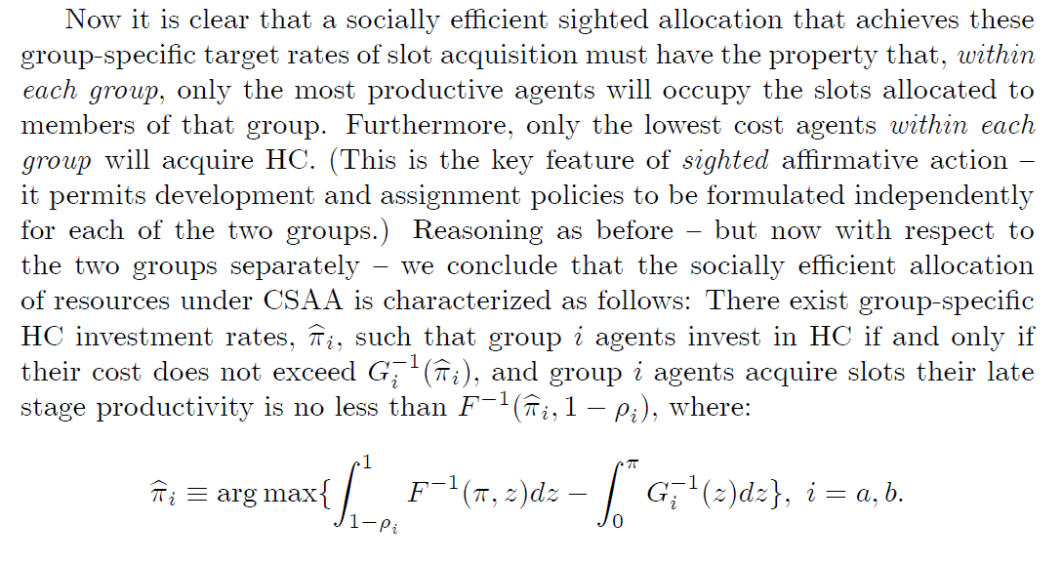

Slide 31
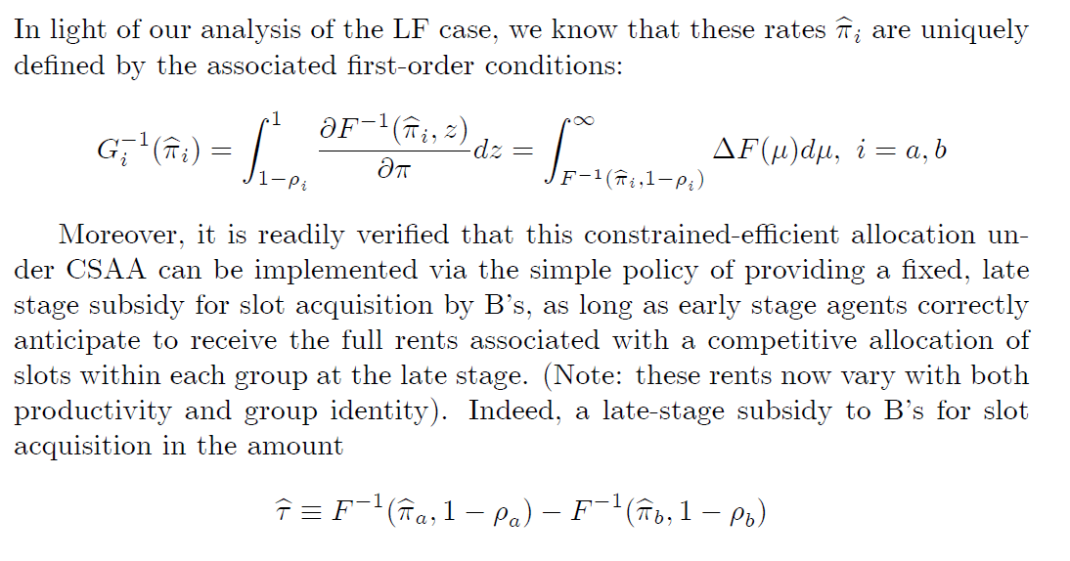


Slide 32
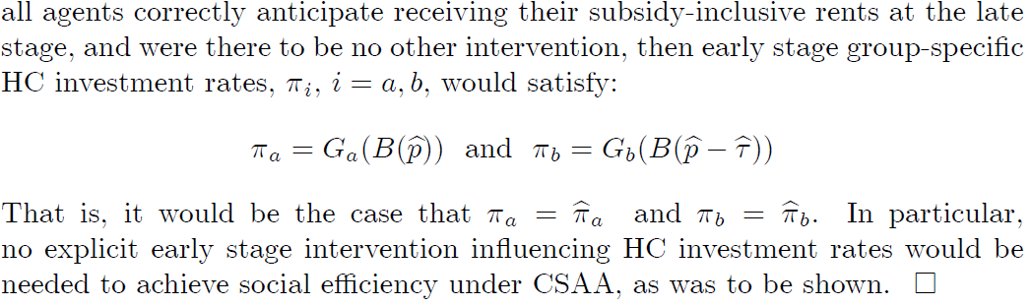

Slide 33
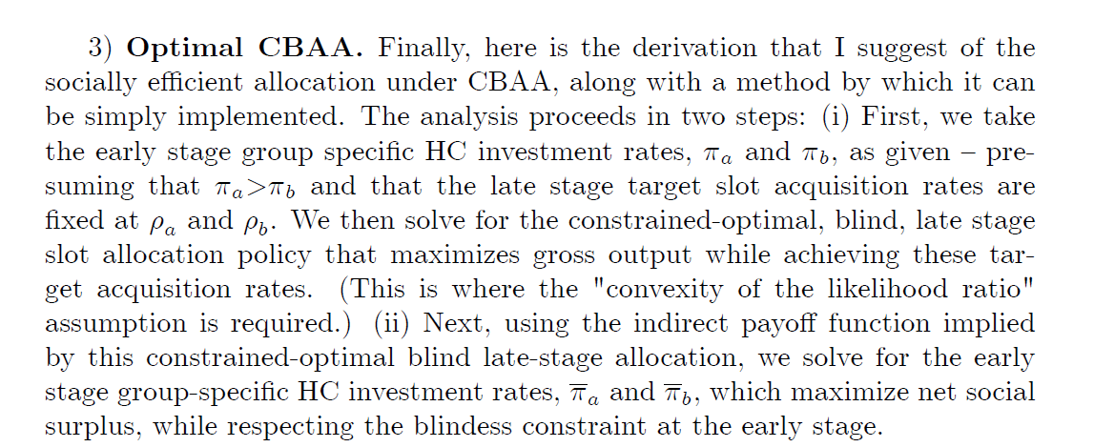

Slide 34
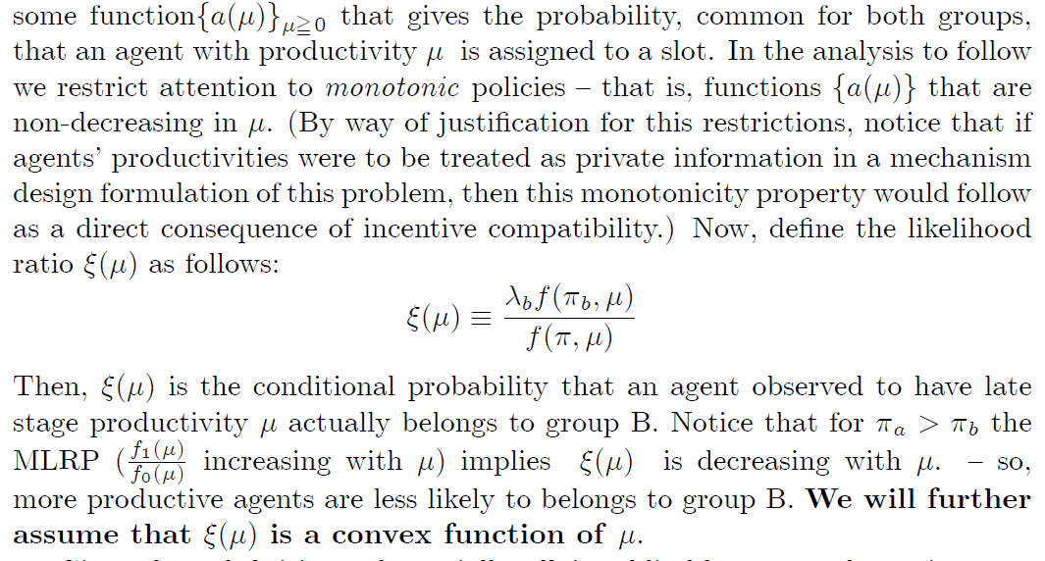

Slide 35

Figure 4: Uniqueness of Equilibrium Under a Convex Likelihood Function
ξ(μ)
0
μ

Slide 36
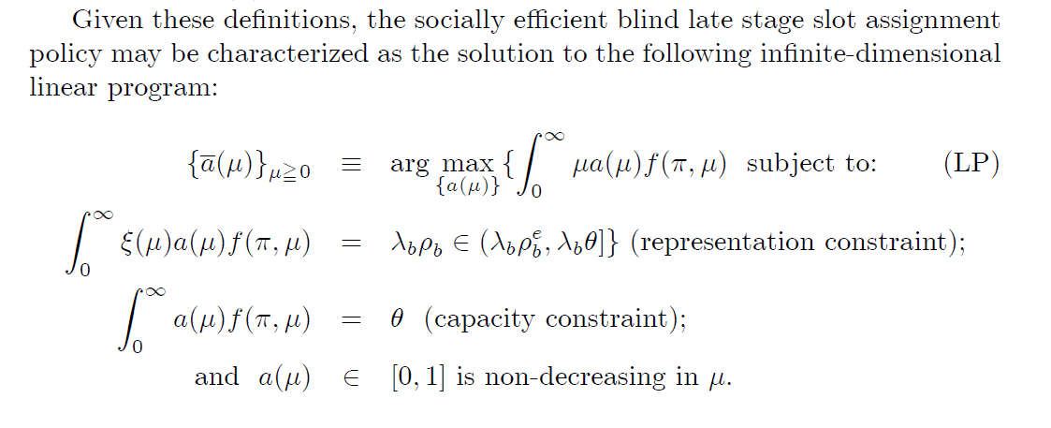

Slide 37
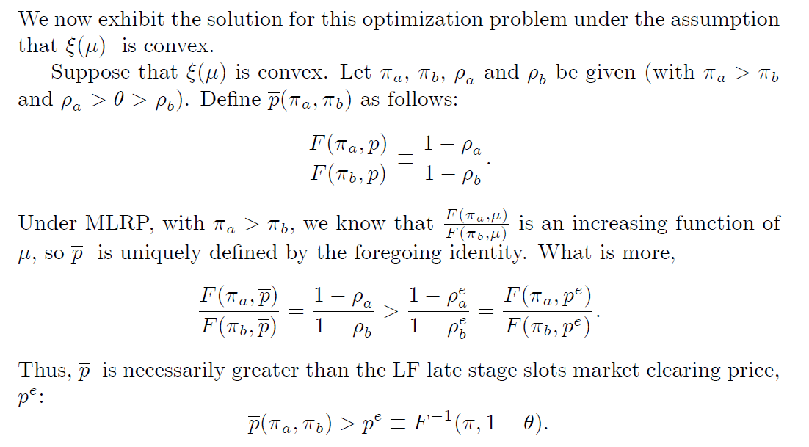

Slide 38
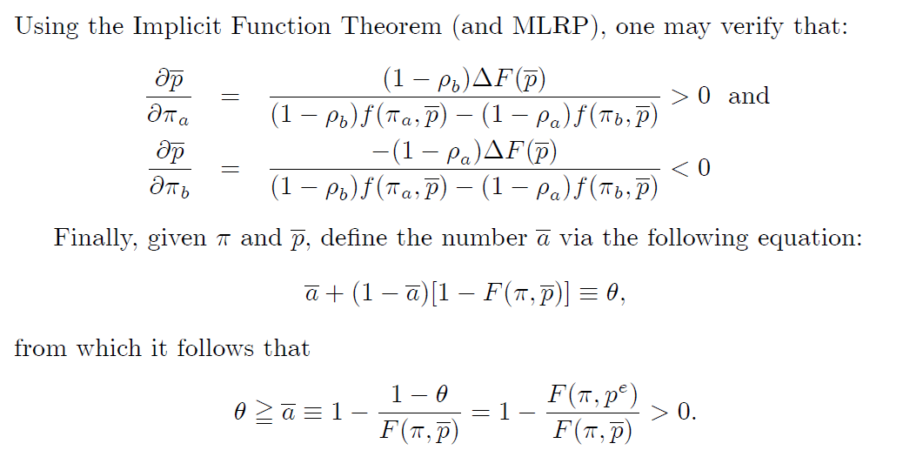

Slide 39
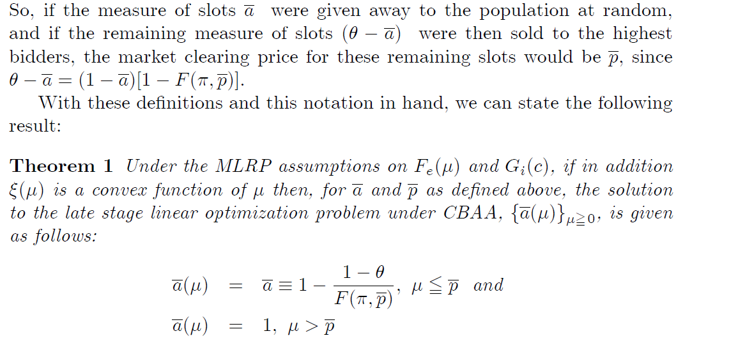

Slide 40
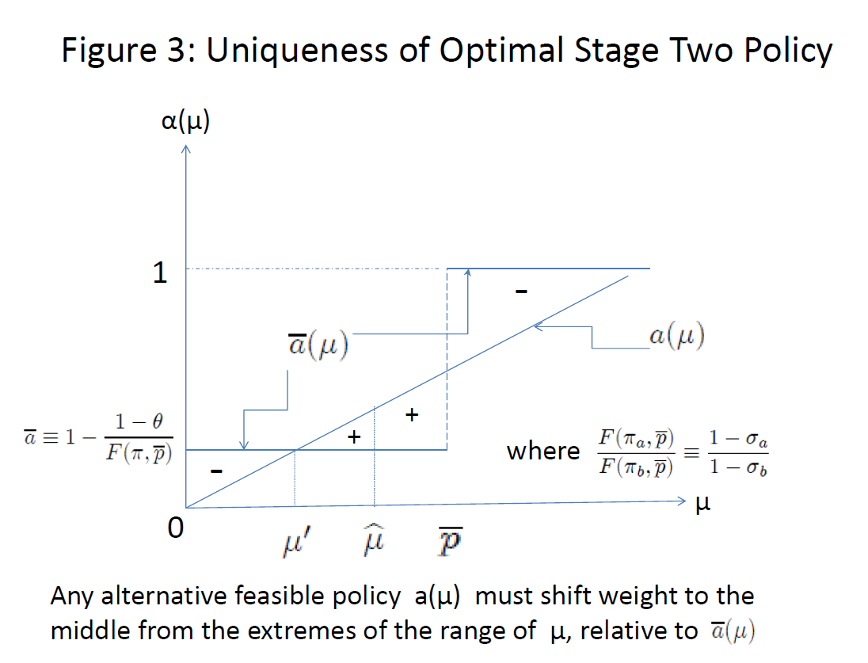

Slide 41
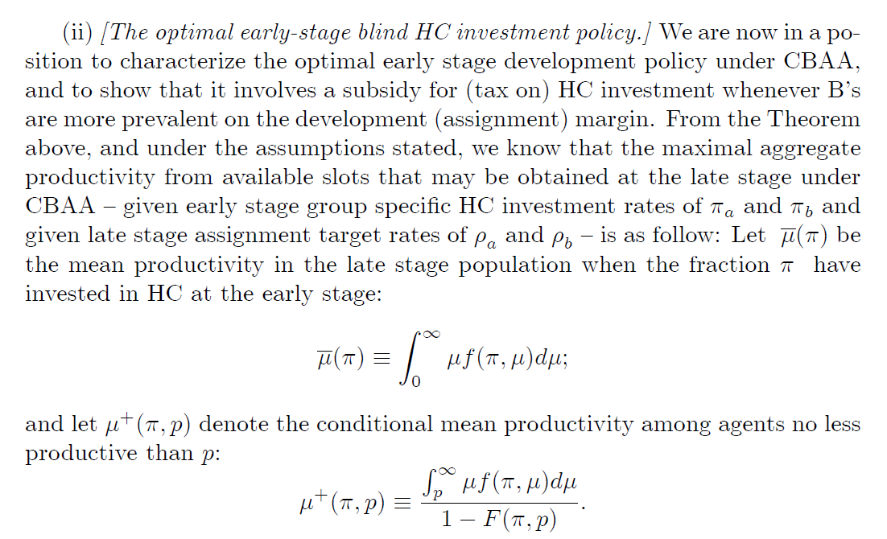

Slide 42
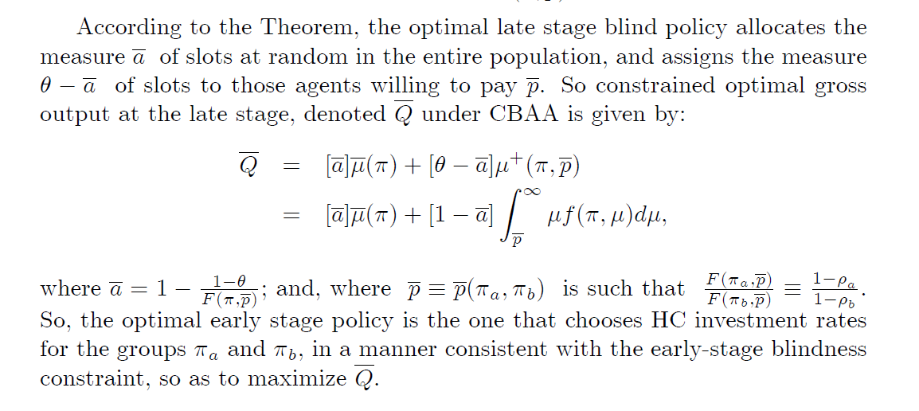

Slide 43
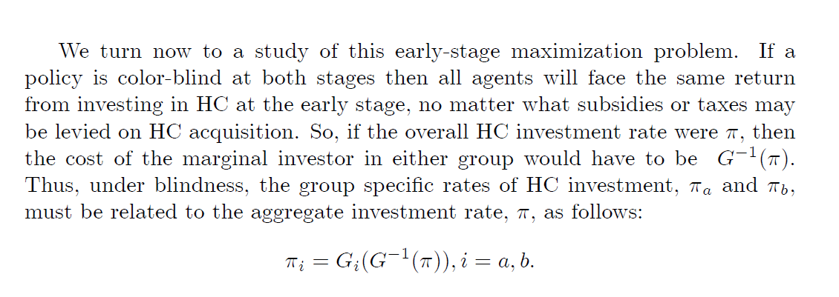

Slide 44
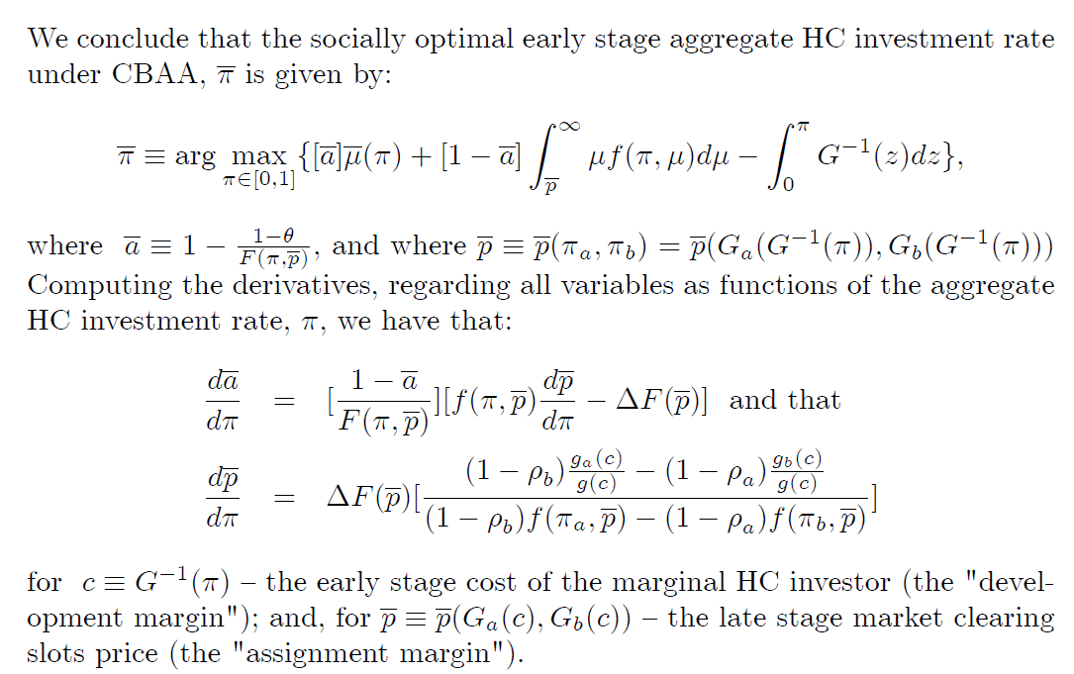

Slide 45
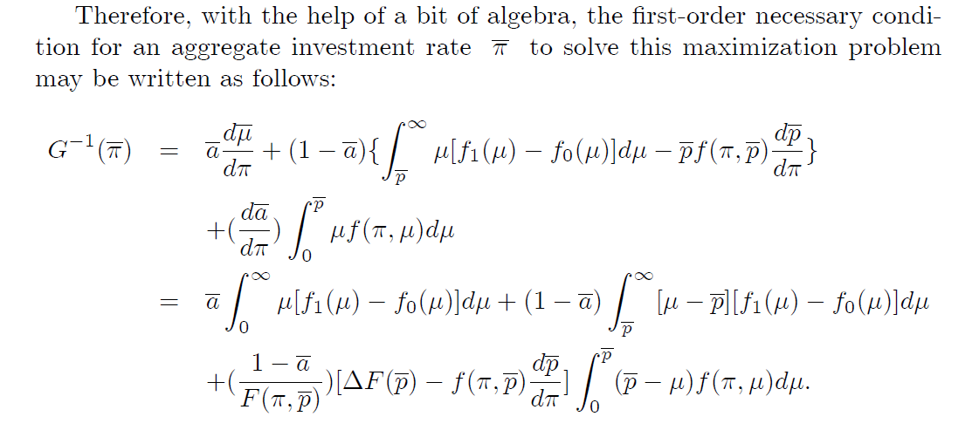

Slide 46
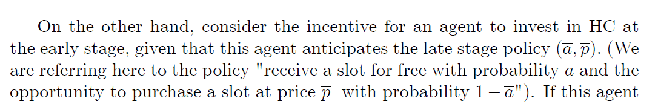
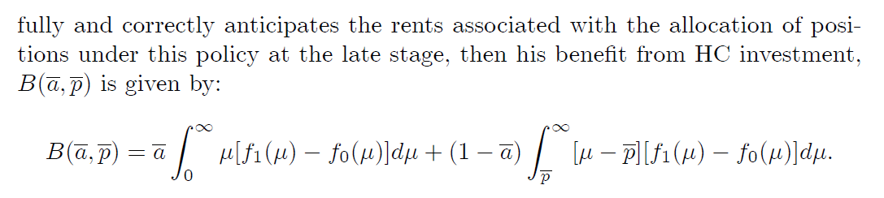

Slide 47
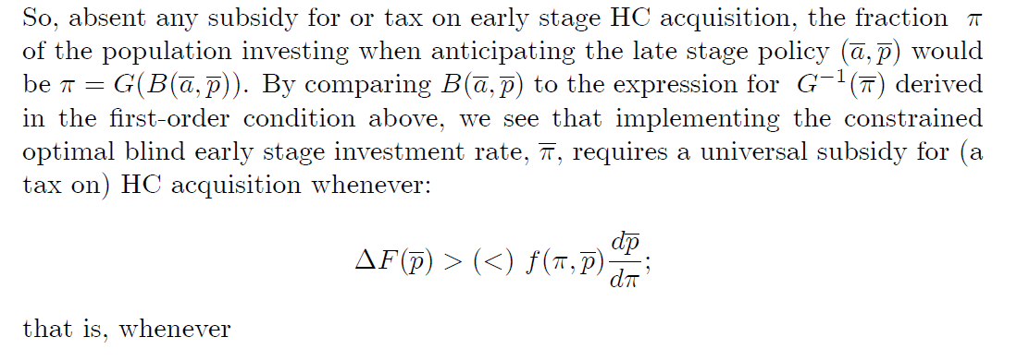
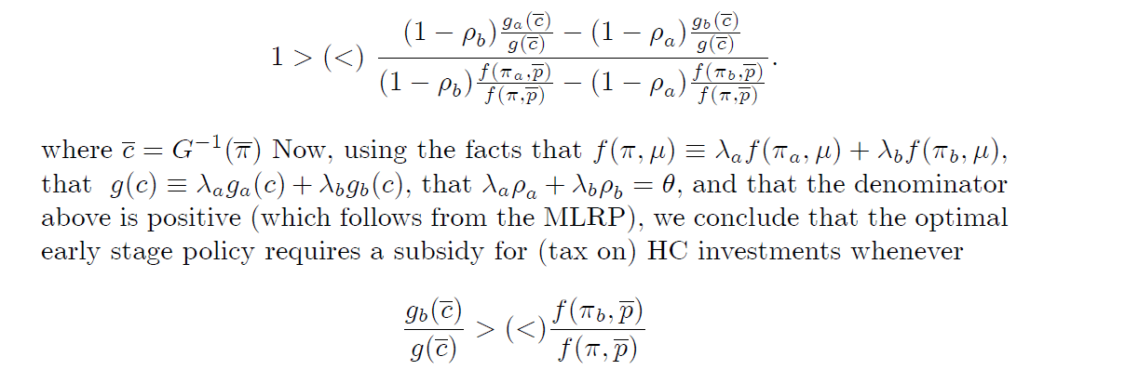

Slide 48
THANK YOU

